Slide 1
RECOGNITION
OF
TOKENS

Slide 2
Recognition of Tokens
In the previous section we learned how to express patterns using regular expressions.
Now, we must study how to take the patterns for all the needed tokens and build a piece of code that examines the input string and finds a prefix that is a lexeme matching one of the patterns.
Consider the following example:
stmt → if expr then stmt
→ if expr then stmt else stmt
→ ε
expr → term relop term
→ term
term → id
→ number

Slide 3
Recognition of Tokens
The grammar describes a simple form of branching statements and conditional expressions.
The terminals of the grammar, which are if, then, else, relop, id, and number, are the names of tokens as far as the lexical analyzer is concerned. The patterns for these tokens are described using regular definitions.
Letter → [A-Za-z]
Digit → [0-9]
ID → {Letter} ({Letter} | {Digit} )*
NUMBER → {Digit}+
IF → if
ELSE → else
THEN → then
RELOP → < | <= | > | >= | == | !=
To simplify matters, we make the common assumption that keywords are also reserved words: that is, they are not identifiers, even though their lexemes match the pattern for identifiers.

Slide 4
Recognition of Tokens
In addition, we assign the lexical analyzer the job of stripping out white-space, by recognizing the "token" ws defined by:
WS → (blank | tab | newline)⁺
Here, blank, tab, and newline are abstract symbols that we use to express the ASCII characters of the same names.
Token ws is different from the other tokens in that, when we recognize it, we do not return it to the parser.

Slide 5
Recognition of Tokens
The following table shows, for each lexeme or family of lexemes, which token name is returned to the parser and what attribute value.
LEXEMES | TOKEN NAME | ATTRIBUTE VALUE
Any ws | - | -
if | if | -
then | then | -
else | else | -
Any Id | id | Pointer to Symbol Table Entry
Any Number | number | Value
< | relop | LT
<= | relop | LE
> | relop | GT
>= | relop | GE
== | relop | EQ
!= | relop | NE

Slide 6
Recognition of Tokens - Transition Diagrams
As an intermediate step in the construction of a lexical analyzer, we first convert patterns into stylized flowcharts, called "transition diagrams“.
Transition diagrams have a collection of nodes or circles, called states.
Each state represents a condition that could occur during the process of scanning the input looking for a lexeme that matches one of several patterns.
Edges are directed from one state of the transition diagram to another. Each edge is labeled by a symbol or set of symbols.

Slide 7
Recognition of Tokens - Transition Diagrams
Some important conventions about transition diagrams are:
One state is designated the start state, or initial state; it is indicated by an edge, labeled "start," entering from nowhere. The transition diagram always begins in the start state before any input symbols have been read.
Certain states are said to be accepting, or final. We always indicate an accepting state by a double circle, and if there is an action to be taken — typically returning a token and an attribute value to the parser.
In addition, if it is necessary to retract the forward pointer one position then we shall additionally place a * near that accepting state.

Slide 8
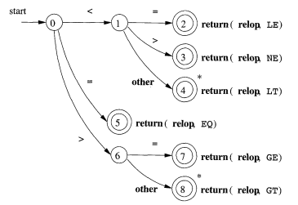
Recognition of Tokens - Transition Diagrams
Transition diagram that recognizes the lexemes matching the token relop

Slide 9
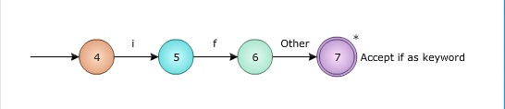
Recognition of Tokens - Transition Diagrams
Recognition of Reserved Words (IF)

Slide 10
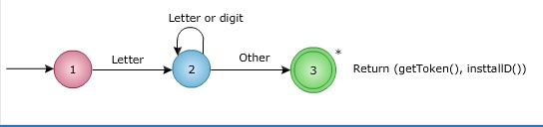
Recognition of Tokens - Transition Diagrams
Recognition of Identifiers

Slide 11
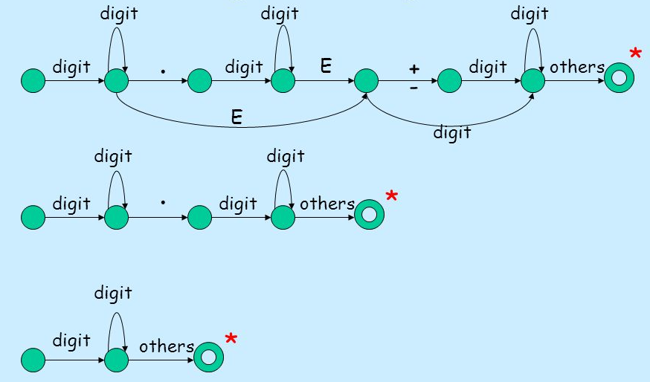
Recognition of Tokens - Transition Diagrams
Recognition of Number

Slide 12
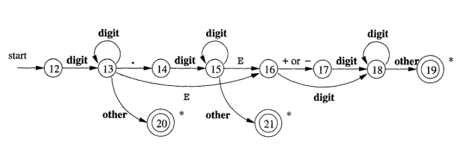
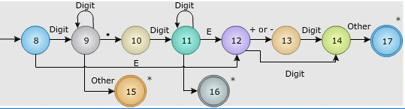
Recognition of Tokens - Transition Diagrams
Recognition of Number

Slide 13
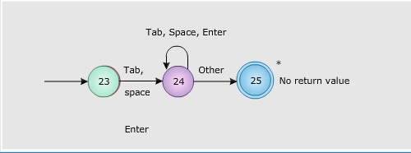
Recognition of Tokens - Transition Diagrams
Recognition of White Spaces

Slide 14
Recognition of Tokens - Transition Diagrams
There are two ways that we can handle reserved words that look like identifiers:
Install the reserved words in the symbol table initially. A field of the symbol-table entry indicates that these strings are never ordinary identifiers, and tells which token they represent. When we find an identifier, a call to installlD places it in the symbol table if it is not already there and returns a pointer to the symbol-table entry for the lexeme found.
Create separate transition diagrams for each keyword.

Slide 15
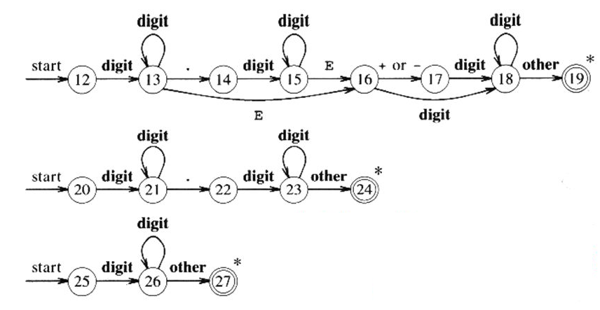
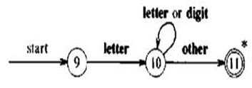
Recognition of Tokens – Implementing a Transition Diagrams

Slide 16
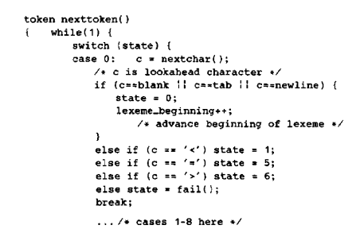
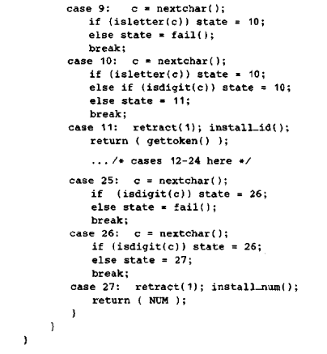
Recognition of Tokens – Implementing a Transition Diagrams

Slide 17
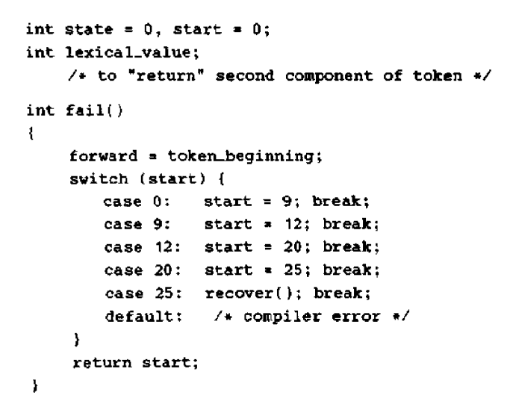
Recognition of Tokens – Implementing a Transition Diagrams

Slide 18
Recognition of Tokens - Finite Automata
We compile a regular expression into a recognizer by constructing a generalized transition diagram called a finite automaton.
Finite automat a are recognizers; they simply say "yes" or "no" about each possible input string.
Finite automat a come in two flavors:
Nondeterministic finite automata (NFA) have no restrictions on the labels of their edges. A symbol can label several edges out of the same state, and ε, the empty string, is a possible label.
Deterministic finite automata (DFA) have, for each state, and for each symbol of its input alphabet exactly one edge with that symbol leaving that state.

Slide 19
Recognition of Tokens - Finite Automata
Non-Deterministic Finite Automata (NFA)
Definition: A NFA is a mathematical model that consists of 5-tuple, M=(S, ∑, S₀, F, δ) where,
S is the set of finite states
∑ is the set of input symbols (The input symbol alphabet)
S₀ is the initial state
F is the set of all accepting states or final states.
δ is the transition function move that maps state-symbol pairs to set of states
A Deterministic Finite Automaton (DFA) is a special case of an NFA where:
There are no moves on input ε, and
For each state s and input symbol a, there is exactly one edge out of s.

Slide 20
Recognition of Tokens - Finite Automata
Difference between NFA and DFA
NFA | DFA
In NFA, more than one transition out of a state may be possible on the same input symbol. | For each state, and for each symbol of its input alphabet exactly one edge with that symbol leaving that state.
There is a Time tradeoff, it is a Slow Recognizer | There is a Time tradeoff, it is a Faster Recognizer
NFA may have ε transitions. | In DFA, There is no ε transitions.
There is a Space tradeoff, it occupies less space | It occupies more space to execute (Much bigger than NFA)

Slide 21
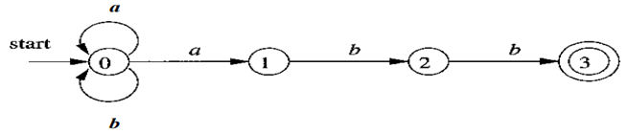
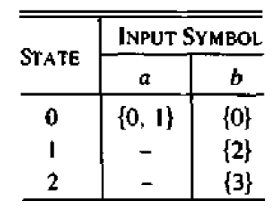
Recognition of Tokens - Finite Automata
NFA or DFA ban be represented by a transition graph, where the nodes are states and the labeled edges represent the transition function. There is an edge labeled a from state s to state t if and only if t is one of the next states for state s and input a.
We can also represent an NFA or DFA by a transition table, whose rows correspond to states, and whose columns correspond to the input symbols.

Slide 22
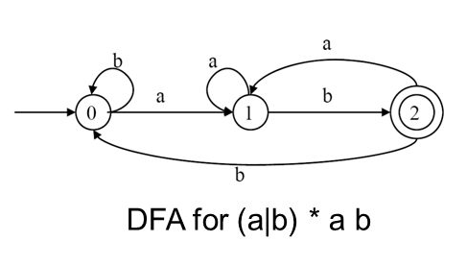
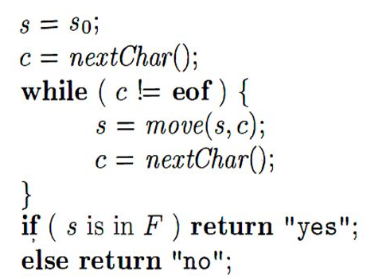
Recognition of Tokens – Regular Expression to DFA
Simulating a DFA

Slide 23
Recognition of Tokens – Regular Expression to DFA
Converting a Regular Expression Directly to a DFA
Algorithm: Construction of a DFA from a regular expression r.
INPUT: A regular expression r.
OUTPUT: A DFA D that recognizes L(r).
METHOD :
Construct a syntax tree T from the augmented regular expression (r)# .
2. Compute nullable, firstpos, lastpos and followpos for T.
3. Construct Dstates, the set of states of DFA D, and Dtran, the transition function for D. The states of D are sets of positions in T. Initially, each state is "unmarked," and a state becomes "marked" just before we consider its out-transitions. The start state of D is firstpos(no), where node no is the root of T. The accepting states are those containing the position for the endmarker symbol #.

Slide 24
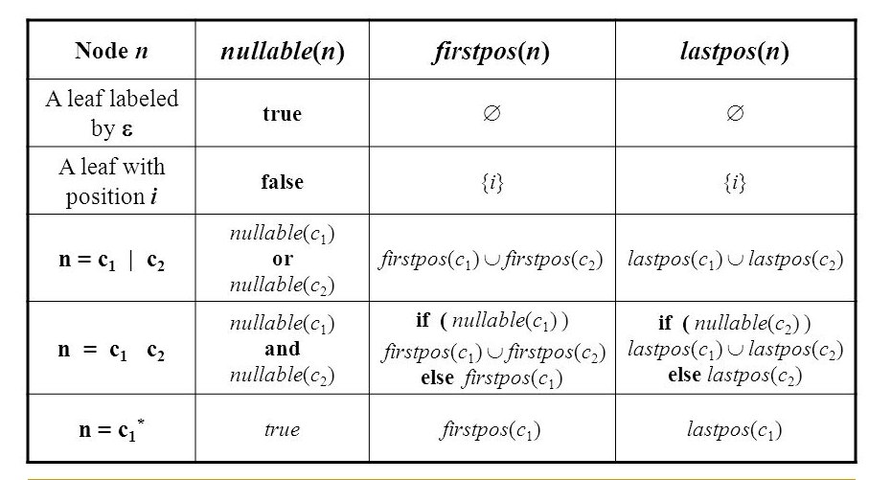
Recognition of Tokens – Regular Expression to DFA
Rules for computing nullable, firstpos and lastpos

Slide 25
Recognition of Tokens – Regular Expression to DFA
Rules for Computing followpos:
There are only two ways that a position of a regular expression can be made to follow another
1. If n is a cat-node with left child C1 and right child C2, then for every position i in lastpos(C1), all positions in firstpos(C2) are in followpos(i).
2. If n is a star-node, and i is a position in lastpos(n), then all positions in firstpos(n) are in followpos(i).

Slide 26
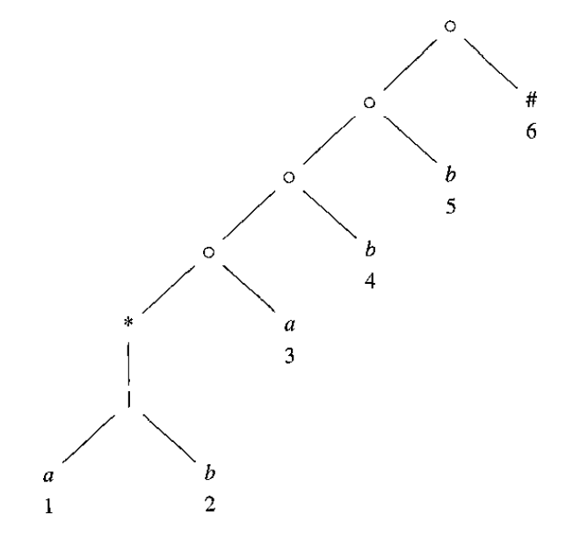
Recognition of Tokens – Regular Expression to DFA
Construct DFA for the regular expression (a|b)*abb
Step1:
Convert the regular expression r into augmented regular expression (r)#.
(a|b)abb#
Step2:
Construct a syntax tree T from the augmented regular expression (r)#
(a|b) a b b #

Slide 27
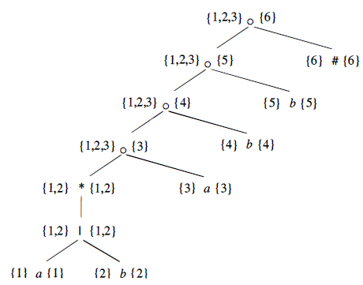
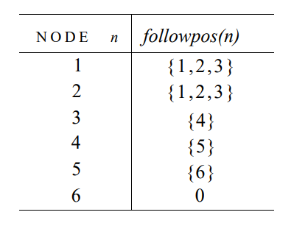
Recognition of Tokens – Regular Expression to DFA
Construct DFA for the regular expression (a|b)*abb
Step3:
Compute nullable, firstpos and lastpos

Slide 28
Recognition of Tokens – Regular Expression to DFA
Construct DFA for the regular expression (a|b)*abb
Step4:
Construct Dstates
The value of firstpos for the root of the tree is {1,2,3} , so this set is the start state of D.
A = {1,2,3}
Dtran[A, a] = followpos(l) U followpos(3) = {1,2,3,4} = B
Dtran[A, b] = followpos(2) = {1,2,3} = A
Dtran[B, a] = followpos(l) U followpos(3) = {1,2,3,4} = B
Dtran[B, b] = followpos(2) U followpos(4) = {1,2,3,5} = C
Dtran[C, a] = followpos(l) U followpos(3) = {1,2,3,4} = B
Dtran[C, b] = followpos(2) U followpos(5) = {1,2,3,6} = D
Dtran[D, a] = followpos(l) U followpos(3) = {1,2,3,4} = B
Dtran[D, b] = followpos(1) = {1,2,3} = A

Slide 29
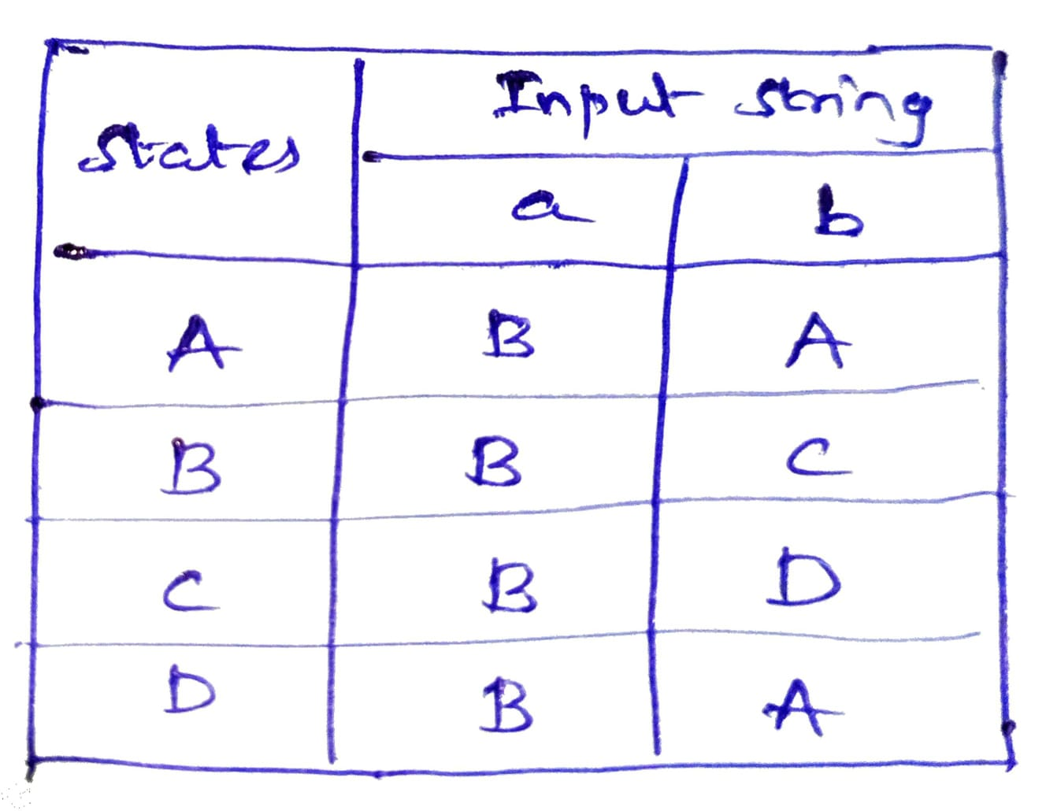
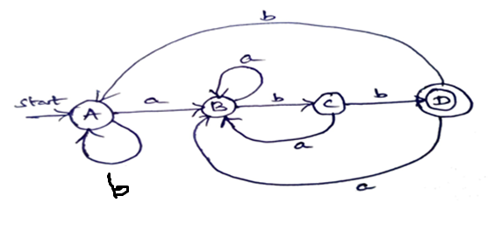
Recognition of Tokens – Regular Expression to DFA
Construct DFA for the regular expression (a|b)*abb
Step5:
Construct DFA Table
Step6:
Draw DFA Diagram

Slide 30
Recognition of Tokens – Regular Expression to DFA
Construct DFA for the following regular expression
a*(a|b)abb(a|b)*
ab(a|b)(a|b)*b*a
(a|b|c)c*abb*
(0|1)101(1|0)*
1*0*10100*

